Slide 1


Debt and Deficit Crises:
Navigating the Realities of a Deleveraging World
Presented by
Christine Hurtsellers, Chief Investment Officer of Fixed Income
For financial professional use only. Not for inspection by, distribution or quotation to, the general public.
CID-1795

Slide 2
Table of Contents
  Perspectives on Deleveraging Cycles
  The Rise of Leverage in the Economy
  Realities of Deleveraging Today
  Navigating A Deleveraging World
  Appendix

Slide 3
1. Perspectives on Deleveraging Cycles

Slide 4
Post-2008, Deleveraging Cycles Have Just Begun
  Debt and deficit levels in the U.S. and Europe are weighing heavily on financial markets and investor sentiment
  GDP growth across the developed world has been disappointing and appears to be slowing; deleveraging is readily cited as a root cause and headwind
  Despite deleveraging progress in the private sector, government borrowing is increasing to finance crisis-related stimulus programs and financial sector bailouts
  Debt to GDP ratios are at historic highs and expected to rise, particularly in developed economies
  Government and business leaders the world over face questions of how to navigate through the difficult times ahead
  Debt levels and leverage grew steadily for more than a decade in the world’s developed economies leading up to The Great Financial Crisis
  The painful process of debt reduction, or deleveraging, has only just begun

Slide 5
Investors Are in Risk Off Mode

Slide 6
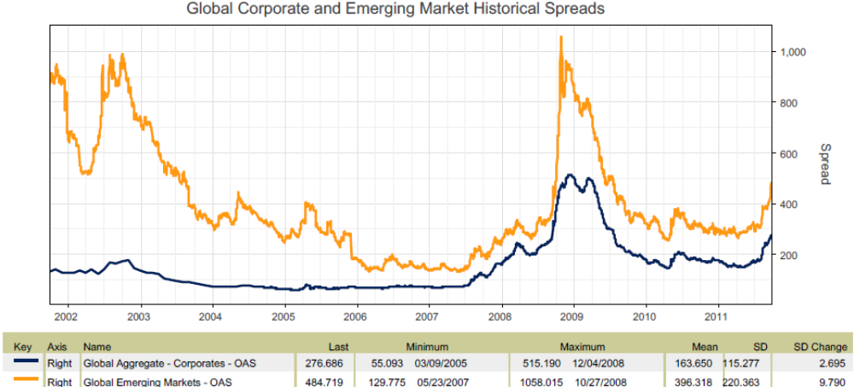
Emerging Markets Are Under Pressure
  On a global and regional basis, the spread tightening cycle has been disrupted by concerns about the sovereign debt crisis in Europe and the potential impact on global economic growth.
Source: Barclays Capital

Slide 7
Growth Has Been Disappointing

Slide 8
Government Debt/GDP Ratios Rising

Slide 9
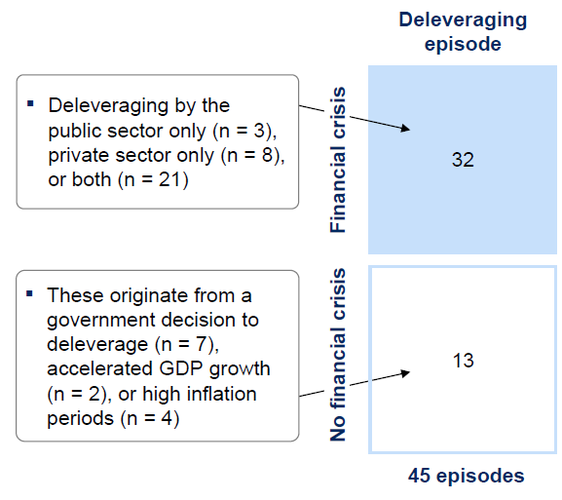
Financial Crises Historically Followed by Deleveraging
  A McKinsey study on global credit bubbles defines a significant deleveraging episode as:
    Ratio of total debt to GDP declines for at least three consecutive years
    Ratio of total debt to GDP falls by 10%
  In 45 such episodes of significant deleveraging since 1950, 32 followed a financial crisis:
Source: McKinsey Global Institute

Slide 10
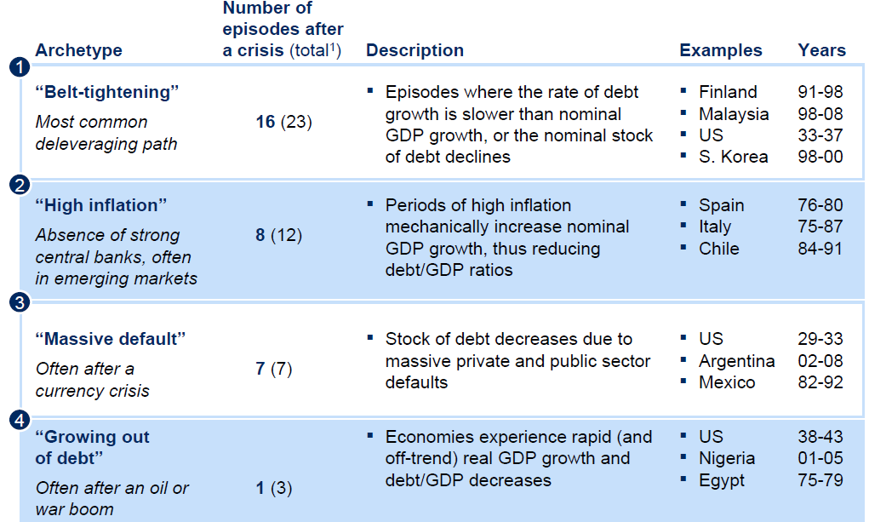
History Groups Deleveraging Cycles Into Archetypes
  Study also suggests that today’s mature economies are most likely to deleverage through a period of austerity, or “belt-tightening”
Source: McKinsey Global Institute

Slide 11
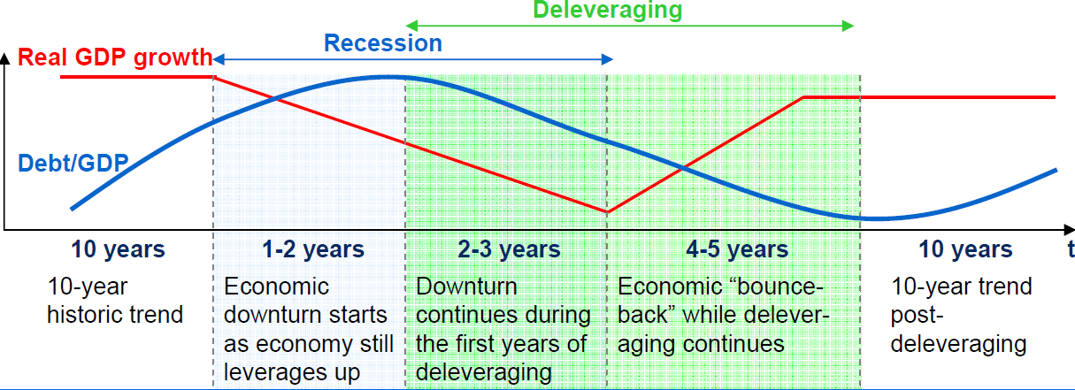
“Belt-Tightening” Periods Have Common Characteristics
  “Belt-Tightening” deleveraging episodes last an average of six to seven years and are accompanied by a recession in the initial years
  Debt to GDP reduced by about 25 percent
  Credit growth in most cases slows dramatically and has been associated with declining GDP in the first two years of deleveraging
  Savings rate increased as borrowers slowly reduced their debt
  Nominal GDP growth maintained
Source: McKinsey Global Institute

Slide 12
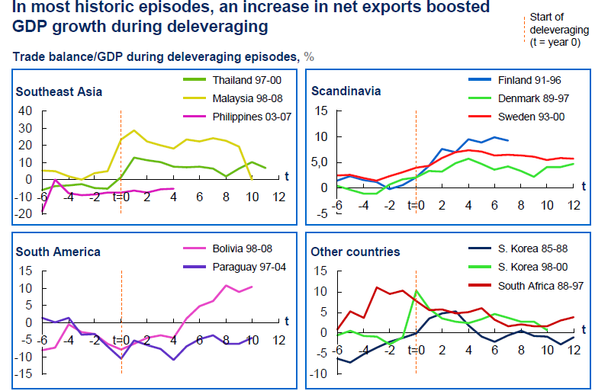
Nominal GDP Maintained Through Other Mechanisms
  If households save more and businesses invest less, GDP will be reduced unless it is supported by another factor
  Expansion of net exports has dampened GDP reduction in the past
Source: McKinsey Global Institute

Slide 13
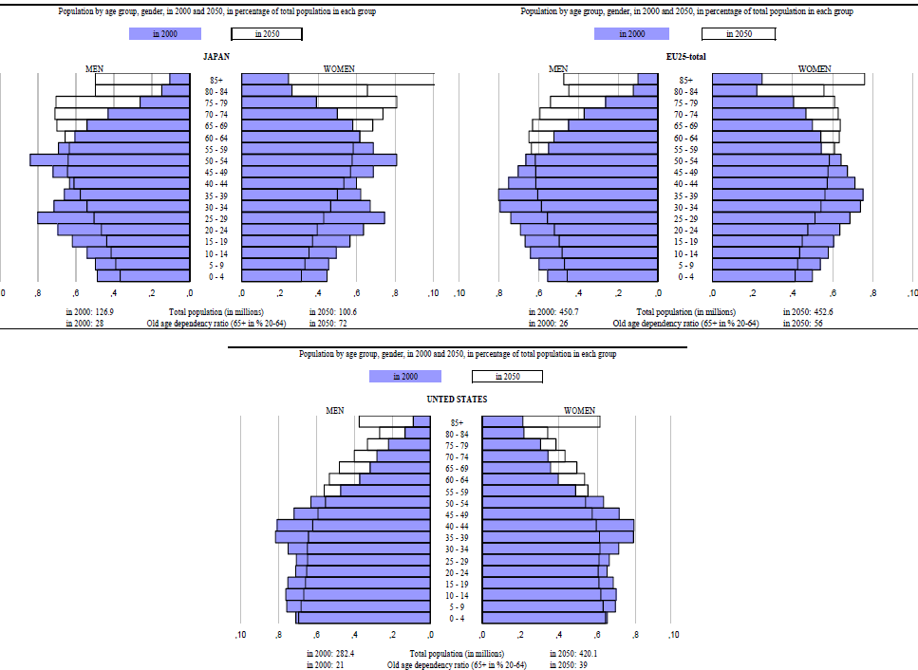
Productivity and Labor Supply Growth Also Supportive; Aging Populations/Demographics May Pose an Issue
Source: OECD Population Data

Slide 14
Deleveraging Today Could Be More Difficult to Navigate
  The crisis today is global in scale
  It is difficult to see how all the affected economies could simultaneously deleverage and maintain nominal GDP growth through traditional mechanisms such as boosting net exports or increasing labor supply/ bolstering productivity
  Financial bailouts and stimulus programs have shifted debt from private sector to the public sector, resulting in rising government debt, delaying the start of deleveraging
  Many developed countries, such as the US and UK, relay on foreign investors to fund their government debt, leaving these countries vulnerable to possible changes in foreign investor sentiment
  The result is that deleveraging process for indebted countries will most likely decline more slowly and over a longer period than history would indicate
Source: McKinsey Global Institute

Slide 15
2. The Rise of Leverage in the Economy

Slide 16
What Led to Higher Leverage
  Lower real income and real wage growth
  Easier access to credit
  Greater income inequality
  Financial engineering and the rise of shadow banking
  Housing bubble
  Public policy
  Globalization and saving glut

Slide 17
Leveraging Up!

Slide 18
The Private Sector Was Leveraging Up until the Global Financial Crisis

Slide 19
Households’ Real Income Has Stagnated Since the Turn of the Century

Slide 20
Employment Growth Stagnated Since the Beginning of the Century

Slide 21
Real Wages Have Declined Since the Early 1970s

Slide 22
Housing Bubble in the U.S. and Elsewhere Fueled Household Borrowing

Slide 23
The Shadow Banking System Had an Important Role in Increased Leverage
Note: Following Pozsar et al (2010) shadow banking liabilities refer to the sum of total outstanding open market paper, total repo liabilities, net securities loaned, total GSE liabilities and pool securities, total liabilities of ABS issues, and total shares of outstanding money market funds

Slide 24
3. Realities of Deleveraging Today

Slide 25
The Public Sector Has Become Highly Leveraged
  The Federal deficit has risen sharply following the financial crisis
  Tax revenues fell sharply, while outlays increased due to “automatic stabilizers,” fiscal stimulus, and ARRA (American Recovery and Reinvestment Act)
  The Federal debt as a share of GDP has risen markedly to over 80%
  Contrary to the view that fiscal deficit would crowd out private investment and raise interest rate, long-term rates remain very low due to exceptionally low short-term rates
  An aging population and rising health care costs entail fiscal costs
  The U.S. public debt ratios are not unusually high, compared to other developed countries. Among major countries Japan and Italy have higher debt ratios than the U.S.
  While developed countries have high public debt and deficits, most emerging market economies have low public debt and deficits

Slide 26
The Federal Deficit Has Risen Sharply Due to the Financial Crisis

Slide 27
Tax Revenues Fell While Outlays Increased in Response to the Financial Crisis

Slide 28
Federal Debt as a Share of National Income
Has Risen Markedly

Slide 29
Developed Countries Have High Public Debt and Deficits, But Emerging Market Economies Don’t

Slide 30
The Private Sector Has Started to Deleverage At Last
  The private sector, particularly U.S. household, has started to deleverage. The Household sector has reduced its debt and improved its balance sheet.
  Household financial obligation and debt service ratios have declined to lower rates, increase in the personal saving rate, and increase in mortgage delinquencies and defaults.
  However, private sector deleveraging lowers economic growth, slows employment growth and raises the unemployment rate

Slide 31
The U.S. Private Sector Is Deleveraging

Slide 32
Households Have Reduced Their Debt

Slide 33
Households’ Balance Sheets Have Improved

Slide 34
Households’ Financial Obligation and Debt Service Ratios Have Declined

Slide 35
Private Sector Deleveraging Lowers Growth and…

Slide 36
…Slows Employment Growth And…

Slide 37
…Raises the Unemployment Rate

Slide 38
4. Navigating A Deleveraging World

Slide 39
Economic Realities of Debt and Deleveraging
  Era of fiscal restraint on the horizon for highly indebted economies as public sector begins the long and painful process of deleveraging
  Debt reduction will be a drag on growth; interest rates will remain low for the foreseeable future
  Monetary policy has been exhausted in the U.S; rate cuts potentially on the horizon for Europe
  Leveraged economies will be more vulnerable to economic shocks and cyclical downturns, lacking the full scope of monetary and fiscal policy to counteract and mitigate downside risks
  Likely to lead to truncated business cycles and more frequent periods of heightened volatility

Slide 40
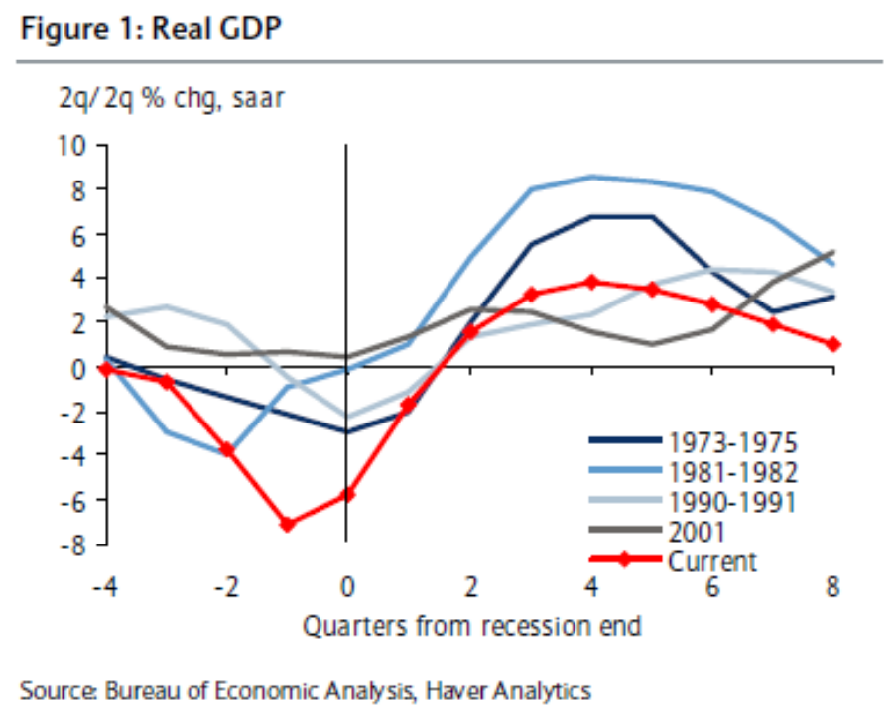
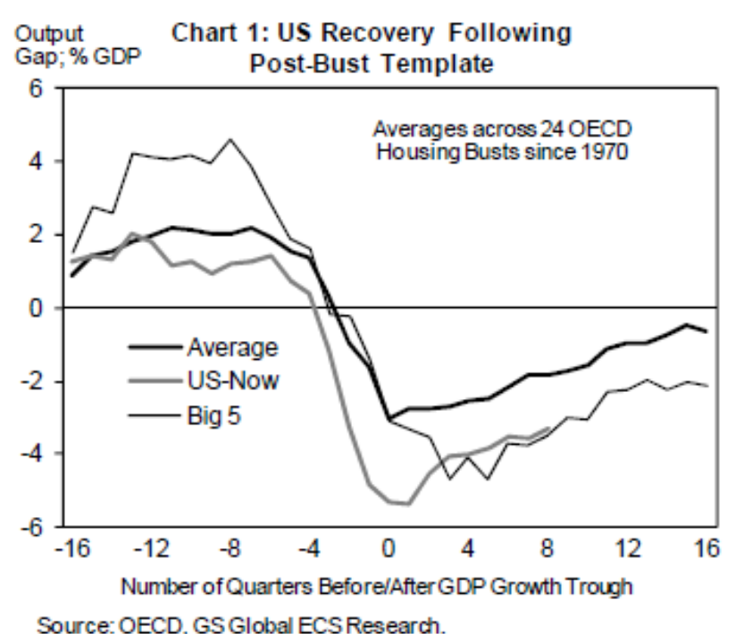
U.S. Economic Recovery Consistent With
Post-Bust Template
  The U.S. recovery from The Great Financial Crisis has been weak relative to previous U.S. post-recession up-turns; however, compared to the previous five largest post-bust recoveries for other countries caused by housing, the U.S. recovery is on track.

Slide 41
U.S. Rates Are Tracking Japan’s Post-Crisis History
Source: Bloomberg

Slide 42
U.S. Government’s Net Interest Payments Are Currently Low Due to Low Rates

Slide 43
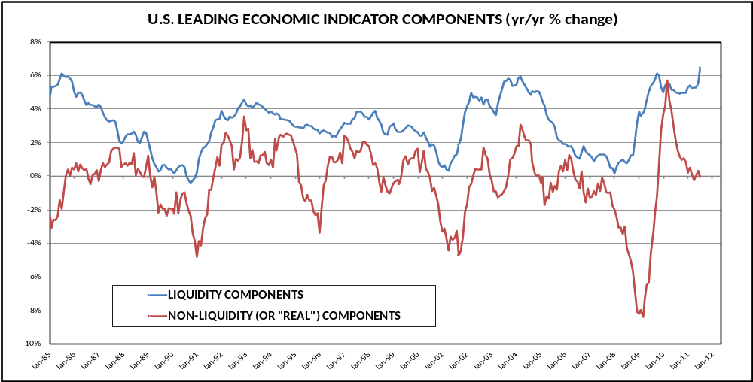
Expect More Business Cycle Volatility
  Monetary policy has been used to smooth the U.S. business cycle over the past 25 years. With the Fed now unable to ease further, expect more frequent and volatile economic cycles driven by changes in real demand.
Source: Bloomberg

Slide 44
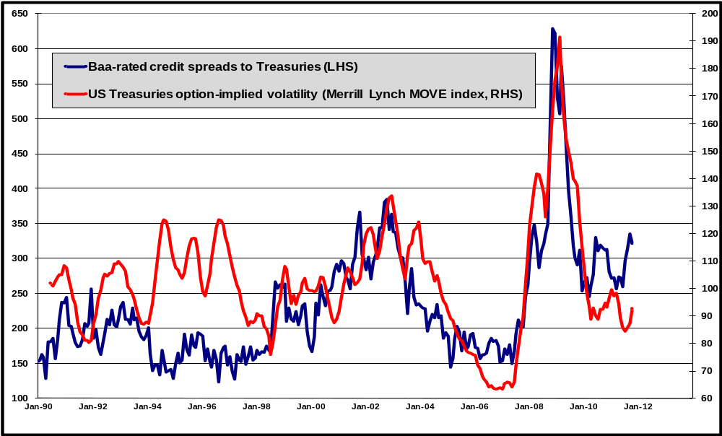
Declining Bond Volatility Will Be Supportive For Credit During the Deleveraging Process
Source: Bloomberg

Slide 45
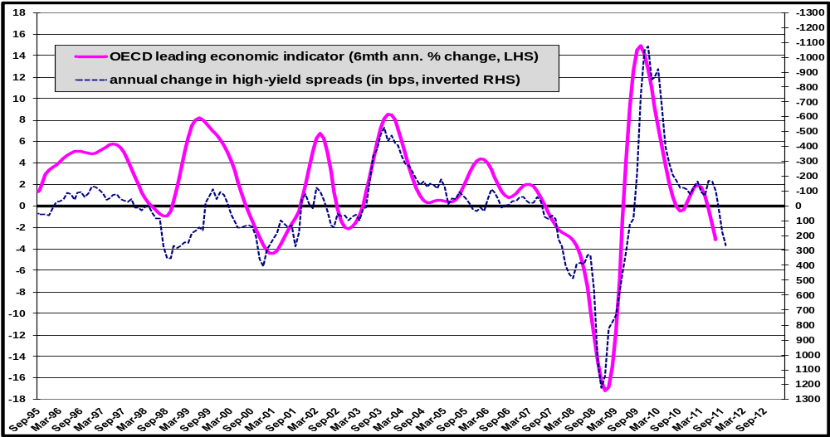
Corporate Credit Markets Are Already Priced
For Recession
  High yield spreads have widened (the blue line declining) as leading economic indicators have contracted (the pink line declining). Credit markets will remain under pressure until growth momentum turns upward.
Source: Bloomberg

Slide 46
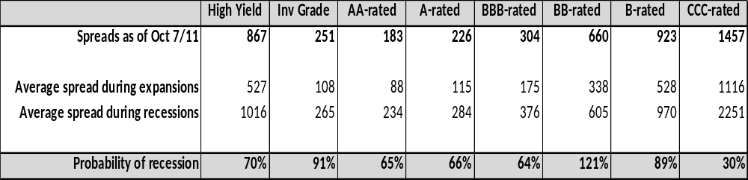
Spread Levels Imply Recession May Be Priced In
Source: J.P. Morgan, ING IM calculations

Slide 47
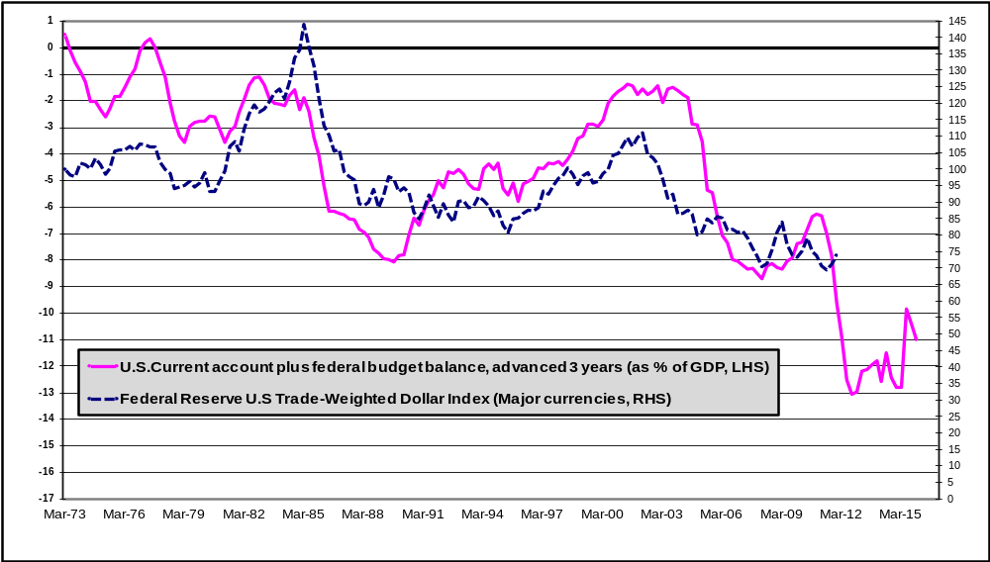
A Weaker Dollar is the Inevitable Consequence of U.S. Policy Stimulus
  The combined effect of chronic U.S. trade deficits (the private sector “supplying” dollars to the world) plus large U.S. fiscal deficits (the public sector “supplying” dollars to the world) will keep the U.S. dollar under downward pressure in the next few years
Source: Bloomberg

Slide 48
Realities of Fixed Income Investing in a
Deleveraging World
  Protracted deleveraging cycles — characterized by fiscal austerity or “belt-tightening,” sluggish economic growth and low short-term interest rates — should keep bond yields low for some time.
  Limitations of Fed policy will likely lead to shorter and more volatile business cycles. Fed actions on short-term interest rates have historically been the strongest driver of Treasury bond volatility.
  However, with short- and long-term rates now explicitly anchored by the Fed, that source of bond volatility has been eliminated.
  In the long-term, the reduction in bond volatility is supportive of credit markets and spread contraction. In the near term, however, the business cycle is trending towards recession, which is driving credit spreads wider.
  Credit spreads in some sectors are approaching levels seen in prior recessions, but the magnitude of the expected downturn could worsen; therefore, we remain cautious on credit allocations in the near-term.

Slide 49
Realities of Fixed Income Investing in a
Deleveraging World
  In a low rate, deleveraging world, interest income will not be the main source of fixed income returns. Getting the asset allocation correct will be more important than ever.
  Investors should be more active in allocating credit exposure in response to more frequent business cycles and periods of heightened volatility
  The biggest consequence of the post-bust policy actions in the U.S. will be that the U.S. dollar stays under downward pressure, particularly against the currencies of Emerging Market economies.
  Emerging Market sovereigns are more fundamentally sound compared to Developed Market sovereigns, and compared to their own history, thus justifying higher core allocations to Emerging Market fixed income.

Slide 50
5. Appendix
Presenter biographies
Important Disclosures

Slide 51
Presenter Bio
Christine Hurtsellers, CFA
Chief Investment Officer, Fixed Income and Proprietary Investments
Years of investment experience: 24
Christine Hurtsellers is Chief Investment Officer of Fixed Income at ING Investment Management U.S., leading a team of more than 100 investment professionals with over $100 billion in fixed income assets under management. She is a member of the ING Global Investment Leadership Team and board member of Pomona Capital. Before assuming the leadership of Fixed Income and Proprietary Investments, Christine was head of Structured Finance from 2005–08. Her mortgage-backed securities team was responsible for the highly successful track record of ING's proprietary mortgage derivatives portfolios, and she directed portfolio and sector strategy across fixed income asset classes. Prior to joining ING Investment Management U.S. in 2004, Christine developed extensive mortgage portfolio management experience, most notably at the Federal Home Loan Mortgage Corporation (“Freddie Mac”), where she led the agency guaranteed retained portfolio team with $650 billion in assets under management. Prior to that role, Christine managed multiple products for Freddie Mac, including mortgage derivatives, adjustable rate mortgages and collateralized mortgage obligations (CMOs); her team pioneered the use of specified collateral in CMO deals, which today is the market standard. Prior to Freddie Mac, she was a portfolio manager responsible for mortgages, structured products, municipals and corporates at Alliance Capital Management and Banc One, and a client consultant at Pentalpha Capital group. Christine earned a B.A. in finance (with high honors) from Indiana University Kelley School of Business and holds the Chartered Financial Analyst® designation.

Slide 52
Disclosure

